Slide 1
HEPATITIS-B

Slide 2
Hepatitis B (formerly known as “serum” hepatitis) is an acute systemic infection with major pathology in the liver, caused by hepatitis B virus (HBV).
HBV infection can be either acute or chronic, and may range from asymptomatic infection or mild disease, to severe, or rarely fulminant hepatitis.
Acute hepatitis B is usually a self-limiting disease marked by acute inflammation and hepatocellular necrosis with case fatality rate of 0.5 to 1 per cent.

Slide 3
Chronic hepatitis B infection encompasses a spectrum of disease and is defined as persistent HBV infection with or without associated active viral replication and evidence of hepatocellular injury and inflammation.
Age is a key factor in determining the risk of chronic infection.
Worldwide, the majority of persons with CHB were infected at birth or in early childhood (13).
Hepatitis B virus can form a dangerous alliance with delta virus and produce a new form of virulent hepatitis which is considered to be widespread threat for much of the world.

Slide 4
Agent factors
AGENT:
Hepatitis B virus was discovered by Blumberg in 1963. Efforts to grow this virus have been so far unsuccessful.
HBV is a complex, 42-nm. double shelled DNA virus, originally known as the Dane particle.
It replicates in the liver cells, it occurs in three morphological forms in the serum of the patient,
small spherical particles with an average diameter of 22-nm. These are antigenic and stimulate production of surface antigens.
tubules of varying length and diameter.
The Dane particle that morphologically corresponds to Hepatitis-B virus.

Slide 5
RESERVOIR OF INFECTION :
Man is the only reservoir of infection which can be spread either from carriers or from cases. The continued survival of infection is due to the large number of individuals who carriers of the virus.
The persistent carrier state has been defined as the Presence of HBsAg (with or without concurrent HBeAg) for more than 6 months. Cases may range from inapparent to symptomatic cases.

Slide 6
INFECTIVE MATERIAL :
Contaminated blood is the main source of infection, although the virus has been found in body secretions such as saliva, vaginal secretions and semen of infected persons.
RESISTANCE :
The virus is quite stable and capable of surviving for at least 7 days on environmental surfaces. It can be readily destroyed by sodium hypoclorite, as is by heat sterilization in an autoclave for 30 to 60 minutes.

Slide 7
PERIOD OF COMMUNICABILITY :
The virus is present in the blood during the incubation period (for a month before jaundice) and acute phase of the disease.
Period of communicability is usually several months (occasionally years in chronic carriers) or until disappearance of HBsAg and appearance of surface antibody.

Slide 8
HOST FACTORS
AGE :
The outcomes of HBV infection are age-dependent.
Acute Hepatits-B occurs in approximately 1 per cent of perinatal, 10 per cent of early childhood (1-5 years of age), and 30 per cent of late (>5 years age) HBV infections.
Mortality from fulminant hepatitis B is approximately 70 per cent.
The development of chronic HBV infection is inversely related to age and occurs in approximately 80-90 per cent of persons infected perinatally in 30-50 per cent infected in early childhood (less than 6 years of age).

Slide 9
HIGH-RISK GROUPS:
Certain groups carry higher risks.
The annual incidence of HBV infection in surgeons is estimated to be 50 times greater than that in the general population, and is more than twice that of other physicians.
Other high risk groups comprise recipients of blood transfusions, health care and laboratory personnel, homosexuals, prostitutes, percutaneous drug abusers, infants of HBV carrier mothers, recipients of solid organ transplants and patients who are immunocompromised.
Serological screening and vaccination of high-risk groups is highly recommended.

Slide 10
HEPATITIS B AND HIV INFECTION :
It is estimated that 10 per cent of the 40 million people infected with HIV worldwide are coinfected with HBV.
Although HBV infection appears to have a minimal effect on the progression of HIV, the presence of HIV markedly increases the risk of developing HBV-associated liver cirrhosis and hepatocellular carcinoma.
The mortality rate increases among HIV-positive people due to HBV coinfection both before and after commencement of highly active anti-retroviral therapy.

Slide 11
HUMORAL AND CELLULAR RESPONSES
Hepatitis B virus has three distinct antigens - a surface antigen, also known as ‘’Australia antigen” (HBsAg), a core antigen (HBeAg), and an “e” antigen (HBeAg).
They stimulate the production of corresponding antibodies e.g., surface antibody (anti-HBs), core antibody (anti-HBc) and “e” antibody (anti- HBe).
These antibodies and their antigens constitute very useful markers of HBV infection. Patients with HBV infection are expected to have one or more HBV markers.

Slide 12
Modes of transmission
Parenteral route: Hepatitis B is essentially a blood-borne infection. It is transmitted by infected blood and blood products through transfusions, dialysis, contaminated syringes and needles, pricks of skin, handling of infected blood, accidental inoculation of minute quantities of blood such as may occur during surgical and dental procedures, immunization, traditional tattooing, ear piercing, nose piercing, ritual circumcision, accupuncture, etc.
Perinatal transmission: Spread of infection from HBV carrier mothers to their babies appears to be an important factor for the high prevalence of HBV infection in some regions, particularly China and SE Asia. The risk of infection varies from country to country and unless vaccinated at birth, the majority of children born to mothers who are HBeAg-posilive become chronically infected. The mechanism of perinatal infection is uncertain.

Slide 13
Sexual transmission: There is ample evidence for the spread of infection by intimate contact or by sexual route. Various body fluids including saliva, vaginal, menstrual and seminal fluids have been implicated as vehicles of human transmission. The sexually promiscuous, particularly male homosexuals, are at very high risk of infection with hepatitis B.
Other routes : Transmission from child-to—child, often called horizontal transmission, is responsible for a majority of HBV infections and carriers in parts of the world other than Asia. The researchers believe that the spread occurs through physical contact between children with skin conditions such as cuts or grazes.

Slide 14
Incubation period
30 to 180 days. Lower doses of the virus result often in longer incubation period. The average incubation period is about 75 days.

Slide 15
Clinical picture
The symptoms and manifestations of hepatitis B are similar to those of other types of viral hepatitis.
The picture is complicated by the carrier state and by chronic liver disease, which may follow the infection.
The spectrum of disease and natural history of chronic HBV infection are diverse. In some people, CHB is inactive and does not lead to significant liver disease.
In others, it may cause progressive liver fibrosis, leading to cirrhosis with end-stage liver disease, and markedly increased risk of hepatocellular carcinoma, independent of the presence of cirrhosis - usually many years after initial infection.
Longitudinal studies of untreated persons with CHB show 8-20 per cent cumulation risk of developing cirrhosis over 5 years

Slide 16
In those with cirrhosis, there is an approximately 20 per cent annual risk of hepatic decompensation and the annual incidence of hepatic B related HCC is high, ranging from 1 to 5 per cent.
Untreated patients with decompensated cirrhosis have poor prognosis, with 15-40 per cent survival at 5 years.
Several host and viral factors, especially coinfections HIV, HCV and hepatitis D virus together with other cofactors such as alcohol use, may increase the rate of disease progression and risk of developing HCC.

Slide 17
Diagnosis
There are three distinct antigen antibody systems that relate to HBV infection and a variety of circulating markers that are useful in diagnosis.
The assays that detect the presence of either antigens or antibodies, typically in serum or plasma but also in capillary blood and oral fluid.
These include rapid diagnostic tests (RDTs), and laboratory-based immunoassays, e.g. enzyme immunoassays (EIAs), chemiluminescence immunoassays (CLIAs), and electro chemiluminescence immunoassays (ECLs).

Slide 18
PREVENTION AND CONTAINMENT
Since there is no specific treatment, prevention has been the major aim in managing viral hepatitis B.
Hepatitis B vaccine: The recombinant hepatitis B vaccine was introduced in 1986 and has gradually replaced the plasma-derived hepatitis B vaccine. The active substance in recombinant hepatitis B vaccine is HBsAg.
Hepatitis B vaccine is available as monovalent formulation, or in fixed combination with other vaccines, including DPT, Hib, hepatitis A and inactivated polio.

Slide 19
The dose for adults is 10-20 micrograms initially (depending on the formulation) and again at 1 and 6 months.
Children under 10 years of age should be given half of the adult dose at the same time intervals.
For greatest reliability of absorption, the deltoid muscle is preferred for injection as gluteal injection often results in deposition of vaccine in fat rather than muscle, with fewer serologic conversion.
For infants and children under 2 years, anterolateral aspect of thigh is used as vaccination site. Intradermal administration is not recommended because the immune response is less reliable particularly in children.

Slide 20
Pentavalent Vaccine : It is a combined vaccine giving protection against diphtheria, pertussis, tetanus, hepatitis B and Hib.
Hepatitis B immunoglobulin (HBIG): For immediate protection, HBIG is used for those acutely exposed to HBsAg-positive blood, for example,
(a) surgeons, nurses or laboratory workers
(b) newborn infants of carrier mothers
(c) sexual contacts of acute hepatitis B patients, and
(d) patients who need protection against HBV infection after liver transplantation.
The HBIG should be given as soon as possible after an accidental inoculation (ideally within 6 hours and preferably not later than 48 hours).

Slide 21
Passive-active immunization: The simultaneous administration of HBIG and hepatitis B vaccine is more efficacious than HBIG alone.
HBIG does not interfere with the antibody response to the hepatitis B vaccine.
This combined procedure is ideal both for prophylaxis of persons accidentally exposed to blood known to contain hepatitis B virus, and for prevention of the carrier state in the newborn babies of carrier mothers.
HBIG (0.05-0.07 ml/kg) should be given as soon as possible and within 24 hours, if possible. Hepatitis B virus vaccine 1.0 ml (20 mcg/1.0 ml) should be given intramuscularly within 7 days of exposure, and second and third doses should be given one and six months, respectively, after the first dose.

Slide 22
Other measures: All blood donors should be screened for HBV infection, and those positive for HBsAg also known as Australia antigen should be rejected.
Voluntary blood donation should be encouraged because purchased blood has shown a higher risk of post-transfusion hepatitis.
Health personnel should be alerted to the importance of adequate sterilization of all instruments and to the practice of simple hygienic measures.
Carriers should be told not to share razors or tooth brushes and use barrier methods of contraception: they should not donate blood.

Slide 23
HEPATITIS C

Slide 24
introduction
Hepatitis C is a contagious liver disease that results from infection with the hepatitis C virus.
It can range in severity from a mild illness lasting a few weeks to a serious, lifelong illness.
It is among the most common virus that infect the liver and it has been shown to be a major cause of parenterally transmitted hepatitis.
Every year, 3-4 million people are infected with the hepatitis C virus. About 110 million people are HCV anti-body positive and 71 million are chronically infected and are at risk of developing liver cirrhosis and/or liver cancer.
More than 3.99,000 people died from hepatitis C - related liver diseases in 2016. It is estimated that about 2.3 million people were co-infected with HCV and HIV.

Slide 25
Transmission
The hepatitis C virus is most commonly transmitted through exposure to infectious blood. This can occur through:
(a) receipt of contaminated blood transfusions, blood products and organ transplants.
(b) injections given with contaminated syringes and needle-stick injuries in health-care settings.
(c) injection drug use.
(d) being born to a hepatitis C-infected mother.
Hepatitis C may be transmitted through sex with an infected person or sharing of personal items contaminated with infectious blood, but these are less common. Hepatitis C is not spread through breast milk, food or water, or by casual contact such as hugging, kissing and sharing food or drinks with an infected person.

Slide 26
Incubation period
The incubation period for hepatitis C is 2 weeks to 6 months.

Slide 27
Symptoms
Following initial infection, approximately 80 per cent of people do not exhibit any symptoms.
Those people who are acutely symptomatic may exhibit fever, fatigue, decreased appetite, nausea, vomiting, abdominal pain, dark urine, grey coloured faeces, joint pain and jaundice.
About 15-45 per cent of infected persons spontaneously clear the virus within 6 months of infection without any treatment.
The remaining 55-85 per cent of persons will develop chronic HCV infection.
Of those with chronic HCV infection, the risk of cirrhosis of liver is 15-30 per cent within 20 years

Slide 28
Diagnosis
Diagnosis of acute infection is often missed because a majority of infected people have no symptoms.
Common methods of antibody detection cannot differentiate between acute and chronic infection.
The presence of antibodies against the hepatitis C virus indicates that a person is or has been infected.
The hepatitis C virus recombinant immunoblot assay (RIBA) and hepatitis C virus RNA testing are used to confirm the diagnosis.
Diagnosis of chronic infection is made when antibodies to the hepatitis C virus are present in the blood for more than six months.

Slide 29
Early diagnosis can prevent health problems that may result from infection and prevent transmission to family members and other close contacts.
Some countries recommend screening for people who may be at risk for infection. These include:
(a) people who recevied blood, blood products or organs before screening for hepatitis C virus was implemented, or where screening was not yet widespread
(b) current or former injecting drug users (even those who injected drugs once many years ago);
(c) people on long-term haemodialysis;
(d) health- care workers;
(e) people living with HIV;
(f) people with abnormal liver tests or liver disease, and
(g) infants born to infected mothers; people having invasiv procedures in health care facilities with inadequate infection control; people who have had tattoos and piercings; and people with sexual partners who are HCV infected.

Slide 30
Treatment
Hepatitis C does not always require treatment as the immune response in some people will clear the infection, and some people with chronic infection do not develop liver damage.
When treatment is necessary, the goal of hepatitis C treatment is cure.
The cure rate depends on several factors including the strain of the virus and the type of treatment given.
The standard of care for hepatitis C is changing rapidly.
Until recently, hepatitis C treatment was based on therapy with interferon and ribavirin, which required weekly injections for 48 weeks, cured approximately half of treated patients, but caused frequent and sometimes life-threatening adverse reactions.

Slide 31
Recently, new antiviral drugs have been developed.
These medicines, called direct antiviral agents (DAA) are much more effective, safer and better-tolerated than the older therapies.
Therapy with DAAs can cure most persons with HCV infection and treatment is shorter (usually 12 weeks) and safer.
Although the production cost of DAAs is low, these medicines remain very expensive in many high- and middle-income countries.
The cost of generic version of these medicines are low.

Slide 32
Prevention
Primary prevention:
1- Hand hygiene: including surgical hand preparation, hand washing and use of gloves.
2. Safe and appropriate use of health care injections.
3. Safe handling and disposal of sharps and waste.
4. Provision of comprehensive harm-reduction services to people who inject drugs including sterile injecting equipment.
5. Testing of donated blood for hepatitis B and C.
6. Training of health personnel.
7- Promotion of correct and consistent use of condoms.

Slide 33
Secondary and tertiary prevention:
For people infected with the hepatitis C virus, WHO recommends:
1. education and counselling on options for care and treatment.
2. immunization with the hepatitis A and B vaccines to Prevent coinfection from these hepatitis viruses to Protect their liver.
3. early and appropriate medical management including antiviral therapy if appropriate.
4. regular monitoring for early diagnosis of chronic liver disease.

Slide 34
HEPATITIS D

Slide 35
INTRODUCTION
Hepatitis D is caused by hepatitis D virus that requires HBV for its replication. Hepatitis D cannot occur in the absence of HBV.
The coinfection or super infection of HDV with HBV causes a more severe disease than HBV monoinfection.
It is estimated that globally, 5% of HBsAg positive people are coinfected with HDV and the distribution is resulting in a total of 15-20 million persons infected with HDV world wide.
High-prevalence areas include the Mediterranean, Middle East, Pakistan, Central and Northern Asia. Japan. Taiwan, Greenland and parts of Africa (mainly the horn of Africa and West Africa), the Amazon Basin and certain areas of the Pacific.

Slide 36
Route of transmission
The route of HDV transmission are the same as for HBV: percutaneously or sexually through contact with infected blood or blood products.
Vertical transmission is possible but rare.
•Vaccination against HBV prevents HDV coinfection, and hence expansion of childhood HBV immunization programmes has resulted in a decline in hepatitis D incidence worldwide.
However, in some settings, the increase of hepatitis D prevalence has been observed in people who inject drugs, or as a result of migration from areas where HDV is endemic.

Slide 37
Diagnosis
HDV infection is diagnosed by high titres of Immunoglobulin G (IgG) and Immunoglobulin M (IgM) anti- HDV, and confirmed by detection of HDV RNA in serum.
However, HDV diagnostics are not widely available and there is no standardization for HDV RNA assays, which are used for monitoring response to antiviral therapy.

Slide 38
Treatment
There is no specific treatment for acute or chronic HDV infection.
Persistent HDV replication is the most important predictor of mortality and the need for antiviral therapy.
Pegylated interferon alpha is the only drug effective against HDV; antiviral nucleotide analogues for HBV have no or limited effect on HDV replication.
The optimal duration of therapy is not well defined, nor how long patients need to be HDV RNA negative after the end of therapy to achieve a sustained virological response. More than 1 year of therapy may be necessary.
The overall rate of sustained virological response remains low, including in children, and most patients relapse after discontinuation of therapy. Liver transplantation may be considered for cases of fulminant hepatitis and end-stage liver disease.

Slide 39
Prevention
Prevention and control of HDV infection requires prevention of HBV transmission through hepatitis B immunization, blood safety, injection safety, and harm reduction services.
Hepatitis B immunization does not provide protection against HDV for those already HBV infected.

Slide 40
HEPATITIS-E

Slide 41
The infection caused by the hepatitis E virus (HEV) which was discovered in 1980, is essentially a water-borne disease.
Formerly termed enterically transmitted hepatitis non-A, non-B (HNANB), HEV is a 29-nm to 32-nm RNA virus with4 genotypes (type 1, 2, 3 and 4).
Hepatitis E is found worldwide and different genotypes of the hepatitis E virus determine differences in epidemiology.
For example, genotype 1 is usually seen in developing countries and causes community-level outbreaks while genotype 3 is usually seen in the developed countries, and does not cause outbreaks.
Hepatitis E prevalence is highest in East and South Asia with genotype 1 most commonly found in India.
Countries with limited resources, i.e., limited access to essential water, sanitation, hygiene and health services are frequently affected.

Slide 42
TRANSMISSION
The hepatitis E virus is transmitted mainly through the faecal-oral route, due io faecal contamination of drinking water.
Other transmission routes have been identified, which include :
(a) food-borne transmission from ingestion of products derived from infected animals;
(b) transfusion of infected blood products; and
(c) vertical transmission from a pregnant woman to her foetus.

Slide 43
INCUBATION PERIOD
The incubation period following exposure to the hepatitis E virus ranges from three to eight weeks, with a mean of 40 days.
The period of communicability is unknown.

Slide 44
Symptoms
Symptomatic infection is more common in young adults aged 15-40 years.
Although infection is frequent in children, the disease is mostly asymptomatic or causes a very mild illness without jaundice that goes undiagnosed.
The typical symptoms are jaundice, loss of appetite, abdominal pain and tenderness, nausea and vomiting, fever and enlarged and tender liver.
The symptoms are largely indistinguishable from those experienced during any acute phase of hepatic illness and last for one or two weeks.

Slide 45
In rare cases, acute hepatitis E can result in fulminant hepatitis (acute liver failure) and death.
Fulminant hepatitis occurs more frequently during pregnancy.
Pregnant women are at greater risk of obstetrical complications and mortality from hepatitis E, which can induce a mortality rate of 20 per cent among pregnant women in their third trimester.
Cases of chronic hepaitits E infection have been reported in immunosuppressed people.
Reactivation of hepatitis E infection has also been reported in immunocompromised people.

Slide 46
DIAGNOSIS
Cases of hepatitis E are not clinically distinguishable from other types of acute viral hepatitis. Diagnosis of hepatitis E infection is, therefore, usually based on the detection of specific IgM and IgG antibodies to the virus in the blood.
Additional tests include reverse transcriptase polymerase chain reaction (RT-PCR) to detect the hepatitis E virus RNA in blood and/or stool, but this assay may require specialized laboratory facilities.

Slide 47
TREATMENT
Hepatitis E is usually self-limiting.
Prevention is the most effective approach against the disease as there is no specific treatment for altering the course of acute hepatitis.
Hospitalization is required for fulminant cases and in symptomatic pregnant women. Recovery from disease is always complete.
No specific immunoglobulin prophylaxis is available.

Slide 48
PREVENTION
The risk of infection and transmission can be reduced by maintaining quality standards for public water supplies and establishing proper disposal systems to eliminate sanitary waste.
On an individual level, infection risk can be reduced by :
(a) maintaining hygienic practices such as hand washing with safe water, particularly before handling food;
(b) avoiding drinking water and/or ice of unknown purity;
(c) adhering to WHO safe food practices.
In 2011, the first vaccine to prevent hepatitis E infection was registered in China, although it is not available globally.

Slide 49
HEPATITIS-G

Slide 50
Hepatitis G virus HGV was discovered in 1996.
The prevalence of this infection is still not known.
A few publications provide information on the association of this infection with blood transfusion in India.

Slide 51
ACUTE DIARRHOEAL DISEASES

Slide 52
CLINICAL TYPES OF DIARRHOEAL DISEASE
Acute watery diarrhoea — which lasts several hours to days; the main danger is dehydration, weight loss also occurs if feeding is not continued. The pathogens that usually cause acute diarrhoea include V. cholerae or E. coli bacteria, as well as rotavirus.
Acute bloody diarrhoea - which is also called dysentery - the main dangers are damage of the intestinal mucosa, sepsis and malnutrition; other complications including dehydration, may also occur. It is marked by visible blood in the stools. The most common cause of bloody diarrhoea is shigella, a bacteria that is also a most common cause of severe cases.

Slide 53
Persistent diarrhoea - which lasts 14 days or longer. The main danger is malnutrition and serious non-intestinal infection, dehydration may also occur. Persons with other illness, such as AIDS, are more likely to develop persistent diarrhoea.
Diarrhoea with severe malnutrition (marasmus and Kwashiorkor) - The main dangers are severe systemic infection, dehydration, heart failure, and vitamin and mineral deficiency.

Slide 54
Diarrhoea prevention indicators
(1) Percentage of population using :
(a) improved drinking water sources (urban, rural,total); (For India - urban 97%, rural 90% and total 92%)
(b) improved sanitation facilities (urban, rural, total); (For India - urban 58%, rural 23% and total 34%)
(2) Percentage of one year old immunized against measles; (India-74%)

Slide 55
Percentage of children who are :
- under-weight (moderate and severe) - 0 to 59 months age
(India-43%)
- stunted (moderate and severe) - 0 to 59 months age
(lndia-38.7%)
- exclusively breast-fed - 0 to 5 months age
(India-46%)
- breast-fed with complementary food - 6 to 9 months age
(India-57%)
- still breast-feeding - 20 to 23 food months age
(India-77%)
(4) Vitamin A supplementation coverage rate (percent full coverage) - 6 to 59 months
(India—53%)

Slide 56
Diarrhoea treatment Indicators
Percentage of children under-five years with diarrhoea receiving:
(1) ORT with continuous feeding (India 33%)
(2) ORS packet (India 26%)
(3) Recommended home made fluids (India 20%)
(4) Increased fluids (India 10%)
(5) Continued feeding (India 70%)

Slide 57
Use of oral rehydration therapy
Percentage of children under-five years with diarrhoea receiving oral rehydration therapy (ORS packet or recommended home-made fluids or increased fluids with continued feeding)
(1) Gender - male, female (India - male 34%, female 31%)
(2) Residence - Urban, rural (India - urban 38%, rural 31%)
(3) Wealth index quintiles - poorest, second, middle,ourth, richest (India - 29%, 29%, 31%, 35% and 45%).

Slide 58
Epidemiological determinants
Agent factors
In developing countries, diarrhoea is almost universally infectious in origin. A wide assortment of organisms cause acute diarrhoea, and many of them have been discovered only in recent years such as rotaviruses and Campylobacters.
Until recent years, the identification of pathogens in the stool was only feasible in about 25 per cent of patients with acute diarrhoea. At present, new techniques enable competent laboratories to identify these pathogens in about 75 per cent of cases.

Slide 59
Viruses:
Rotaviruses
Astroviruses
Adenoviruses
Calciviruses
Coronaviruses
Norwalk group viruses
Enteroviruses
Cytomegalovirus

Slide 60
Bacteria:
Campylobacter jejuni Enterotoxigenic Escherichia coli
Shigella Salmonella
Vibrio cholerae Vibrio parahaemolyticus
Bacillus cereus Staphylococcus aureus
Clostridium perfringens Enterohaemorrhagic E. coli
Clostridium difficile Enteroinuasive E. coli
Aeromonas Yersinia enterocolitica
Chlamydia Neisseria gonorrhoeae

Slide 61
Others:
E. histolytica
Giardia intestinalis
Trichuriasis
Cryptosporidium SPP
Intestinal worms
Cyclospora

Slide 62
ROTAVIRUSES :
The rotavirus, first discovered in 1973, has emerged as the leading cause of severe, dehydrating diarrhoea in children aged <5 years globally, with an estimated more than 25 million out-patient visits and more than 2 million hospitalizations attributable to rotavirus infections each year.
In developing countries, three-quarters of children acquire their first episode of rotavirus diarrhoea before the age of 12 months, whereas in developed countries.
The first episode is frequently delayed until the age of 2-5 years. Severe rotavirus gastroenteritis is largely limited to children aged 6-24 months.

Slide 63
Fatal outcomes in children, estimated to be approximately 420,000-494,000 in 2008, occur predominantly in low-income countries.
Rotavirus reinfection is common, although the primary infection is usually the most significant clinically.
In temperate climates, the incidence of rotavirus gastroenteritis typically peaks during the winter season, whereas in tropical settings rotavirus occurs year round and a marked seasonality may be masked by high background levels.

Slide 64
BACTERIAL CAUSES
Besides the well-known bacterial causes of enteric infections and diarrhoeal diseases such as V cholerae 01. Salmonella, Shigella, enterotoxigenic E.coli and Campylobacter jejuni are the most frequent cause of diarrhoea. They produce a potent enterotoxin similar to that produced by V. cholerae. The less-known pathogens which cause diarrhoea are Yersinia enterocolitica, and V parahaemolyticus.
Enterotoxigenic Escherichia coli (ETEC) is an important cause of acute watery diarrhoea in adults and children in developing countries causing annually 280-400 million diarrhoeal episodes in children under 5 years of age, and an additional 100 million episodes in children aged 5-14 years. In adults it causes substantial disease (about 400 million cases per year).

Slide 65
It is also the most common cause of traveller’s diarrhoea. Being responsible for one-third to one half of all diarrhoeal episodes in travellers to Africa, Asia and Latin America, the illness results in 0.3 to 0.5 million deaths per year mostly in young children.
ETEC does not invade the bowel mucosa and the diarrhoea it causes is mediated by toxins.
There are two ETEC toxins, heat labile (LT) and heat stable (ST).
Some strains produce only one type of toxin, some both. The LT toxin is closely related to cholera toxin.
ETEC is spread mostly by means of contaminated food and water.

Slide 66
Salmonella cause inflammation of the bowel epithelium; Vibrio cholerae 01 do not. Both are endemic diseases in India.
In cholera-endemic areas, cholera probably accounts for not more than 5 to 10 per cent of all acute diarrhoeas yearly, and in more than 90 per cent of instances is clinically indistinguishable from other acute diarrhoeas.
Campylobacters are slim, highly motile, S-shaped, gramnegative rods, formerly classed as vibrios. They are one of the commonest causes of enteritis.
They do not seem to produce any toxin. It is not clear how they cause diarrhoea.

Slide 67
Shigella accounts for a high percentage of mortality due to diarrhoeal disease.
The estimates suggest that it causes about 1 million deaths every year in children aged under-5 years, mostly in the developing countries.
In addition about 164.7 million Shigella episodes are estimated worldwide, with 69 per cent of all episodes in young children.
It is a major cause of diarrhoea in India.

Slide 68
Reservoir of infection
For some enteric pathogens, man is the principal reservoir and thus most transmission originates from human factors ; examples are enterotoxigenic E. coli, shigella spp.,V. cholerae, Giardia lamblia and E. histolytica.
For other enteric pathogens, animals are important reservoirs and transmission originates from both human and animal faeces; examples are Campylobacter jejuni, Salmonella spp and Y enterocolitica.
For viral agents of diarrhoea, the role of animal reservoirs in human disease remains uncertain.

Slide 69
HOST FACTORS
Diarrhoea is most common in children especially those between 6 months and 2 years.
Incidence is highest in the age group 6-11 months, when weaning occurs.
It reflects the combined effects of declining levels of maternally acquired antibodies, the lack of active immunity in the infant, the introduction of contaminated food, and direct contact with human or animal faeces when the infant starts to crawl.
It is also common in babies under 6 months of age fed on cow’s milk or infant feeding formulas.
Diarrhoea is more common in persons with malnutrition.
Malnutrition leads to infection and infection to diarrhoea which is a well known vicious circle.
Poverty, prematurity, reduced gastric acidity, immunodeficiency, lack of personal and domestic hygiene and incorrect feeding practices are all contributory factors.

Slide 70
Environmental factors
Distinct seasonal patterns of diarrhoea occur in many geographical areas.
In temperature climates, bacterial diarrhoea occur more frequently during the warm season, whereas viral diarrhoea, particularly diarrhoea caused by rotavirus peak during the winter.
In tropical areas, rotavirus diarrhoea occurs throughout the year, increasing in frequency during the drier, cool months, whereas bacterial diarrhoeas peak during the warmer, rainy season.
The incidence of persistent diarrhoea follows the same seasonal patterns as that of acute watery diarrhoea.

Slide 71
MODE OF TRANSMISSION
Most of the pathogenic organisms that cause diarrhoea and all the pathogens that are known to be major causes of diarrhoea in many countries, are transmitted primarily or exclusively by the faecal-oral route. Faecal-oral transmission may be water-borne; food-borne, or direct
transmission which implies an array of other faecal-oral
routes such as uia fingers, or fomites, or dirt which may be
ingested by young children.

Slide 72
CONTROL
Components of a Diarrhoeal Diseases Control Programme
The intervention measures recommended by WHO be classified as below :
Short-term
Appropriate clinical management.
Long-term
Better MCH care practices.
Preventive strategies.
Preventing diarrhoeal epidemics.

Slide 73
Appropriate clinical management
ORAL REHYDRATION THERAPY :
With introduction of oral rehydration by WHO it is now firmly established that oral rehydration treatment can be safely and successfully used in treating acute diarrhoeas due to all aetiologies, in all age groups, and in all countries.
The aim of oral fluid therapy is to prevent dehydration and reduce mortality.
It has been the experience of workers at Kolkata that as many as 90-95 per cent of all cases of cholera and acute diarrhoea can be treated by oral fluids alone.
Oral fluid therapy is based on the observation that glucose given orally enhances the intestinal absorption of salt and water, and is capable of correcting the electrolyte and water deficit.

Slide 74
More recently an improved ORS formulation has been developed which is as safe and effective as the original in preventing and treating diarrhoeal dehydration but also reduced stool output or offers additional clinical benefit or both.
It is focussed on reducing the osmolarity of ORS solution to avoid possible adverse effects of hypertonicity on net fluid absorption by reducing the concentration of glucose and sodium chloride in the solution.
Decreasing the sodium concentration of ORS solution to 75 mOsm/1 improved the efficacy of the ORS regimen for children with acute non-cholera diarrhoea.

Slide 75
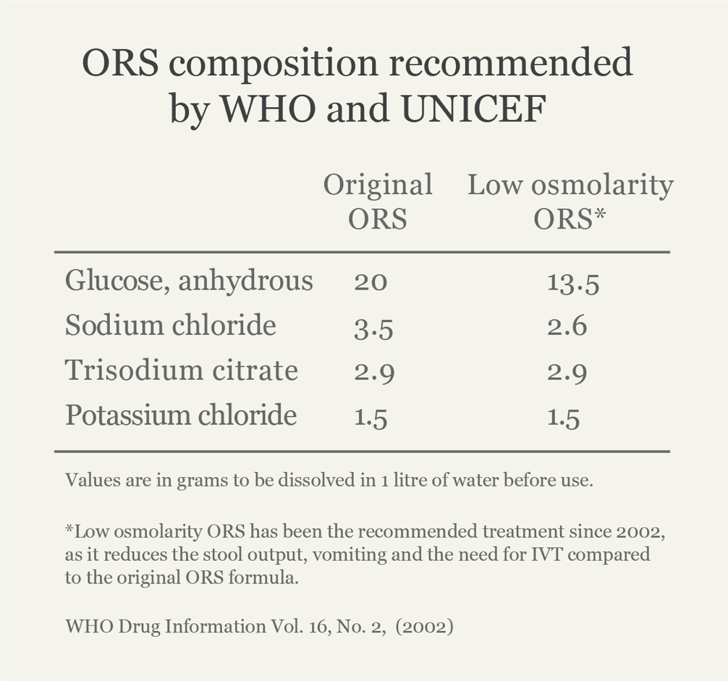

Slide 76
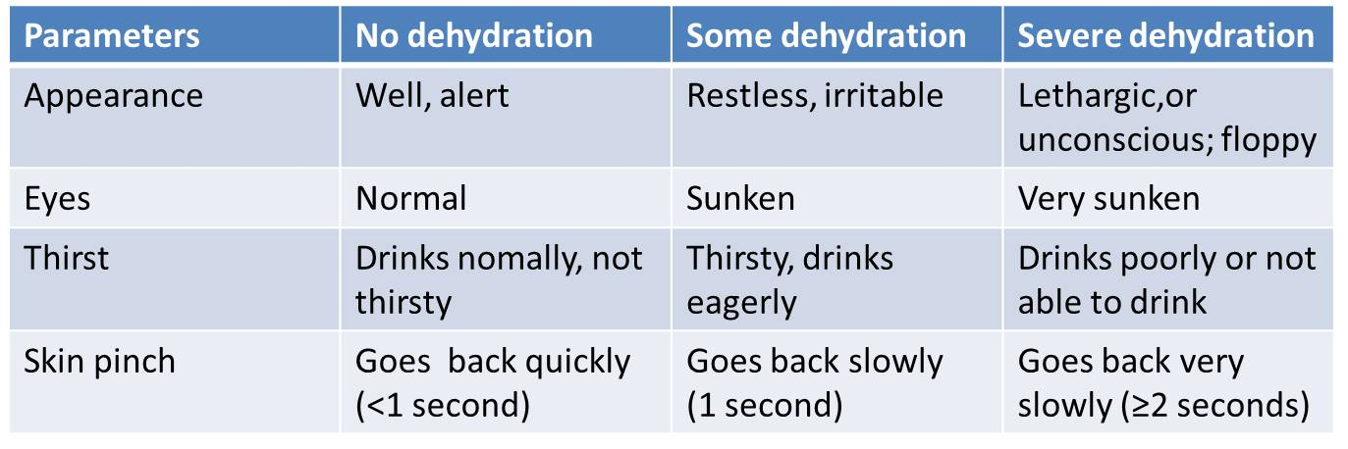
Grades of Dehydration

Slide 77
THANK YOU

